Slide 1
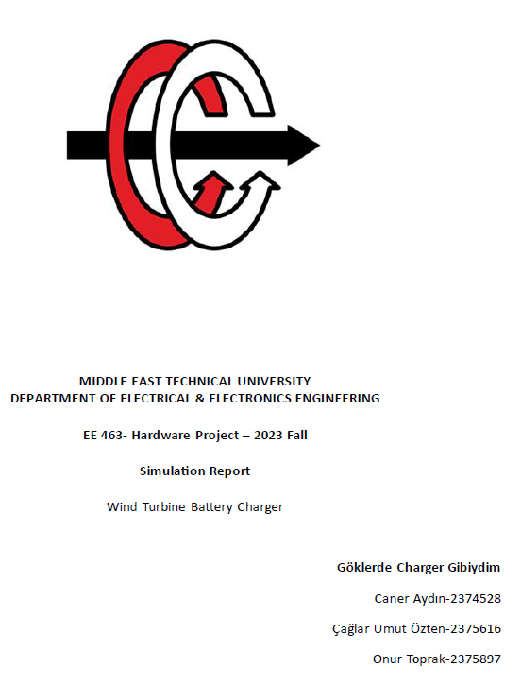

Slide 2
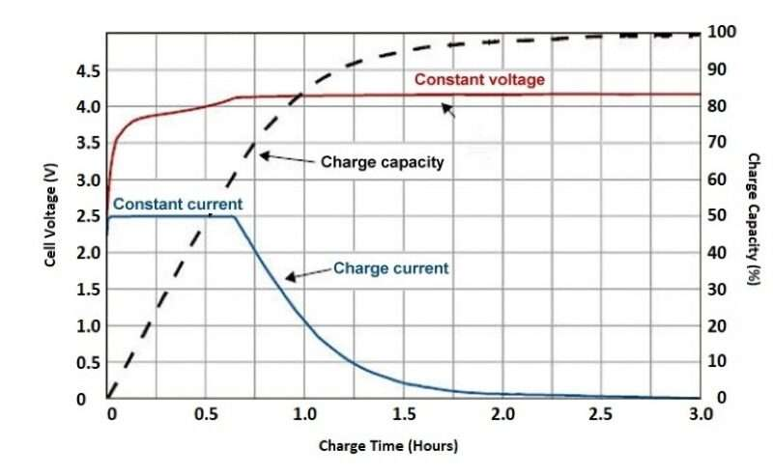
Charging types of battery

Slide 3
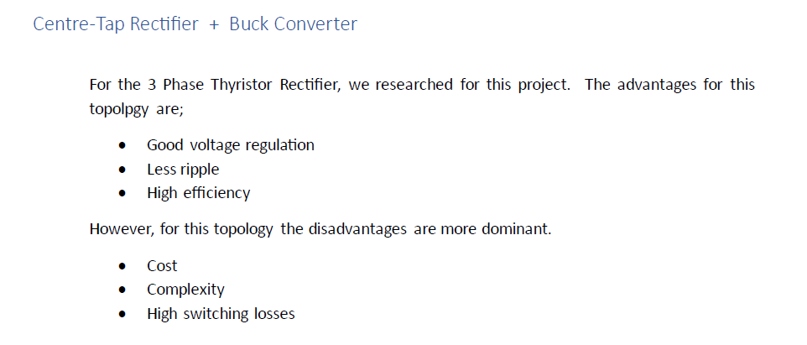
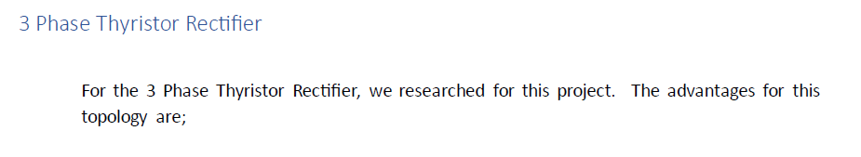
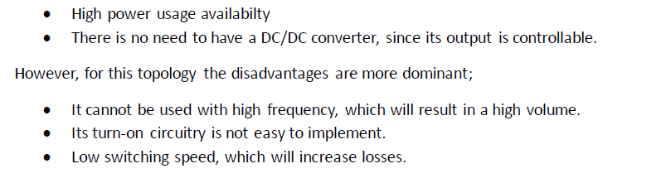
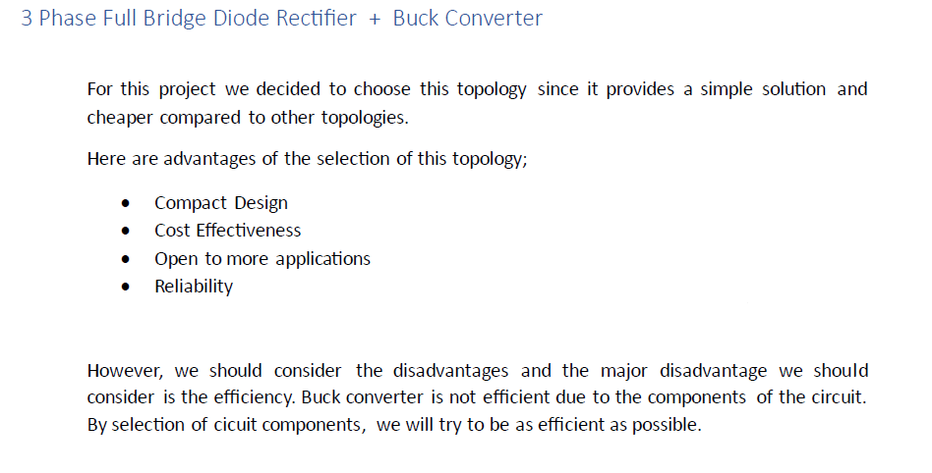

Slide 4
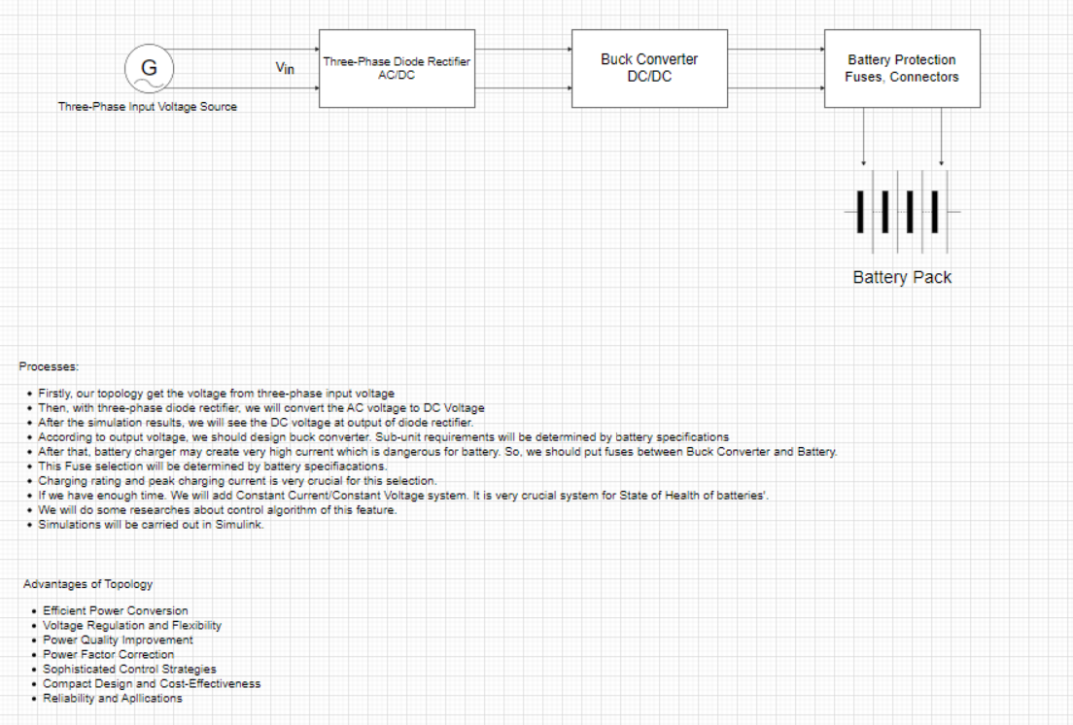

Slide 5
Overall Circuit Schematic for Battery Charger

Slide 6
Diode Current Waveforms (Maximum Input Voltage) and Diode Voltage Waveforms (Maximum Input Voltage)

Slide 7
Output Voltage Waveforms , Output Voltage Waveforms (Maximum Input Voltage)

Slide 8
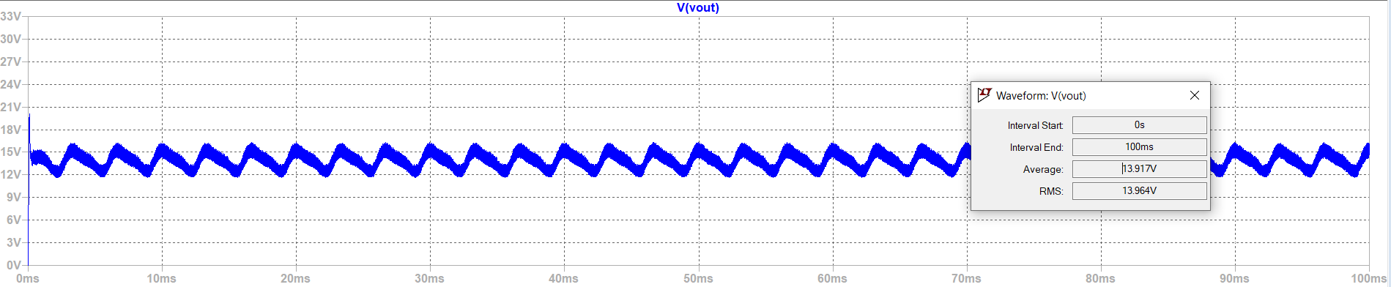
Output Voltage Waveform of Buck Converter

Slide 9
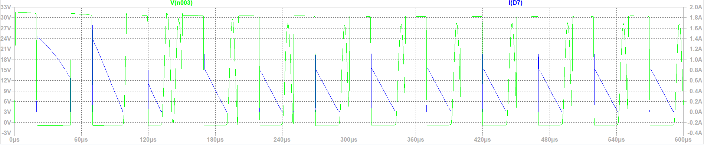
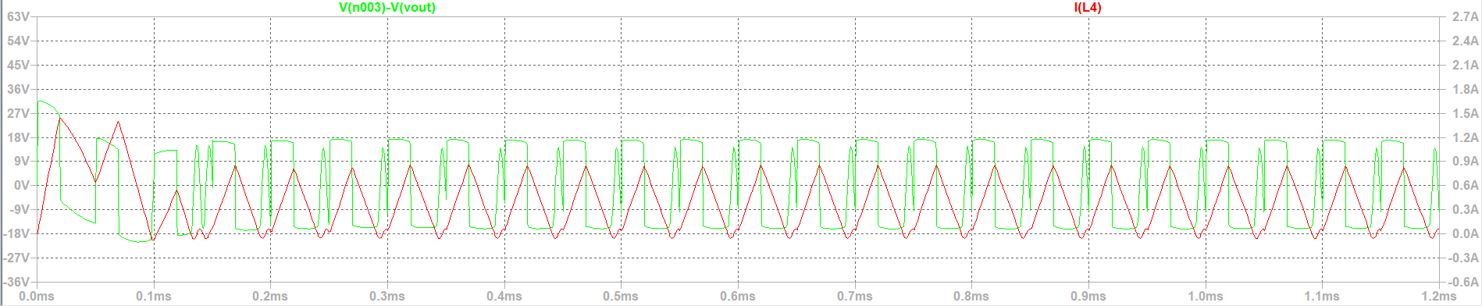
Buck Converter Voltage and Current Waveform of Inductor and Diode

Slide 10
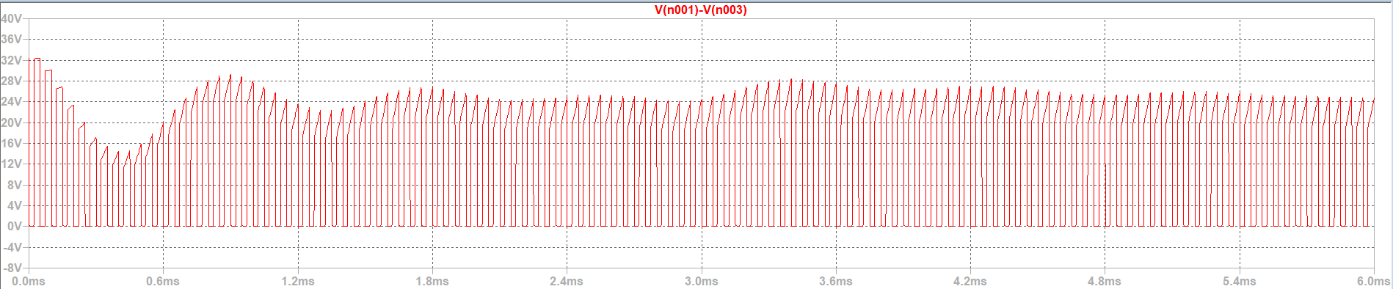
MOSFET Voltage Waveform (Vds)

Slide 11
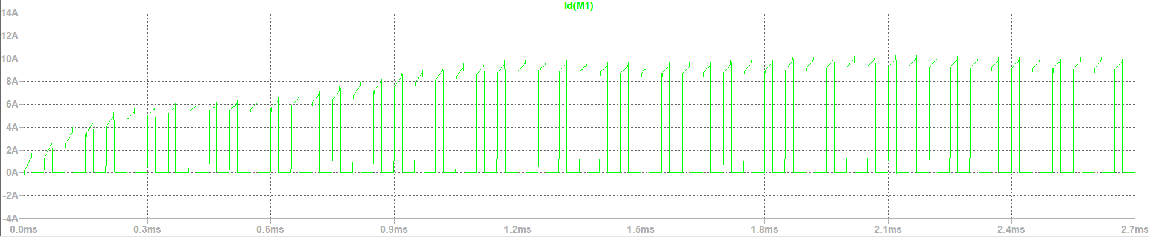
MOSFET Current Waveform (Id)

Slide 12
Gate Signal

Slide 13
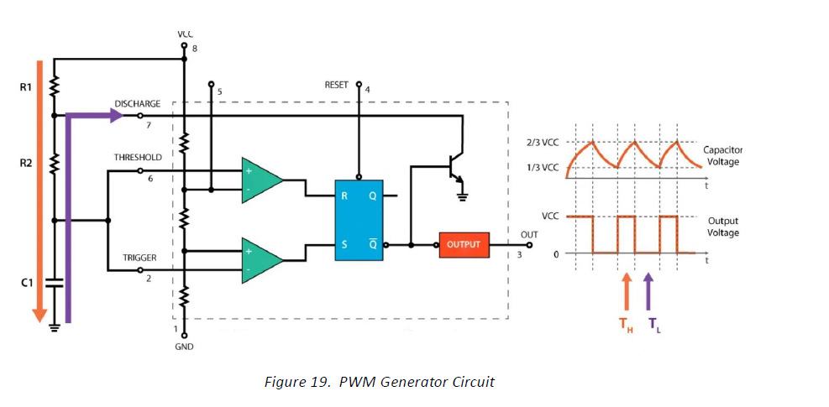
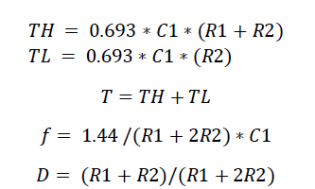
Timer Circuit LM555

Slide 14

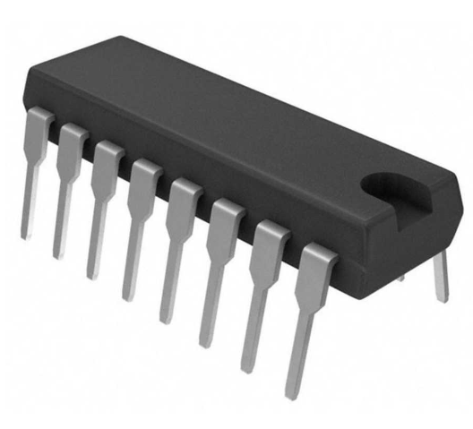
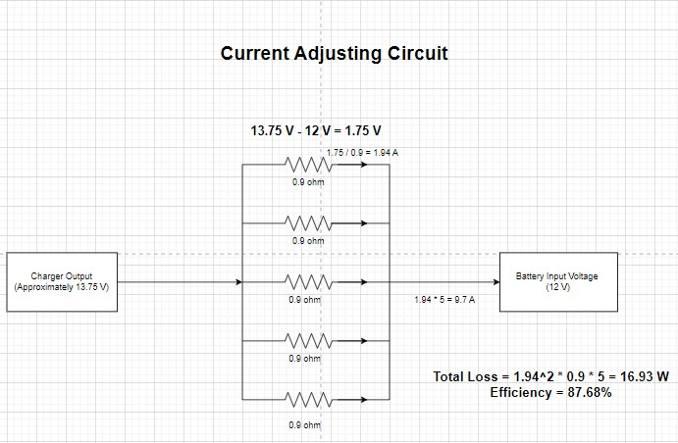
Controller Circuit
TL494 VOLTAGE REGULATOR
Integrated Controller Circuit
Feedback from battery to keep Id 10 A constant.
Voltage regulator at the end with resistor or a regulator

Slide 15
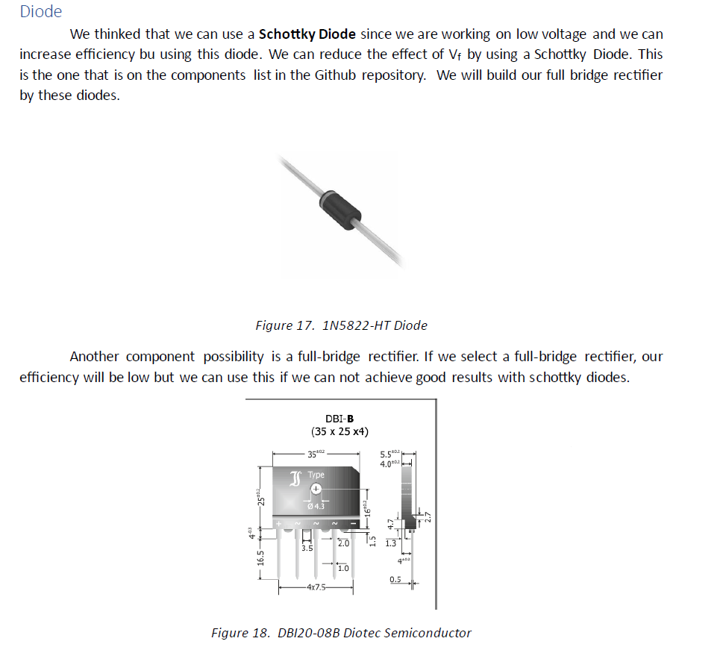
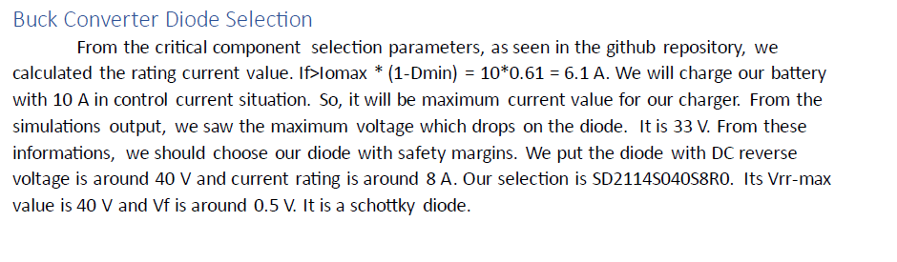
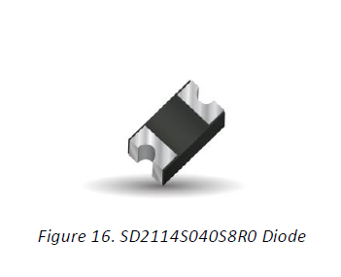
Component Selection
Diode

Slide 16
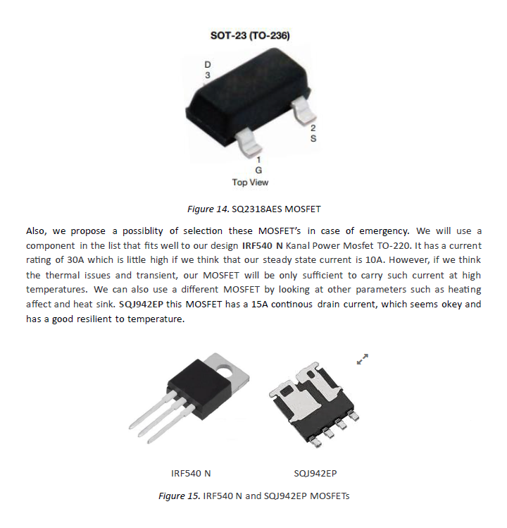
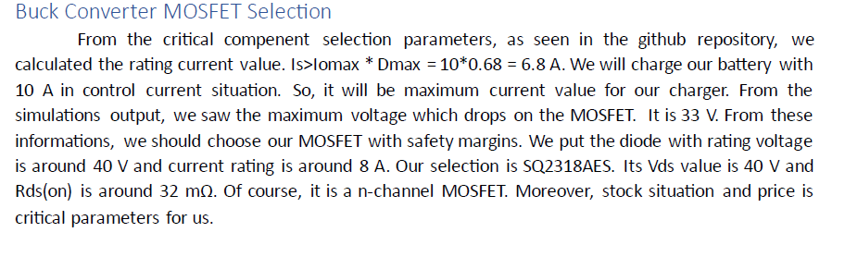
MOSFET
IRF 540 N Mosfet 100V 28A

Slide 17
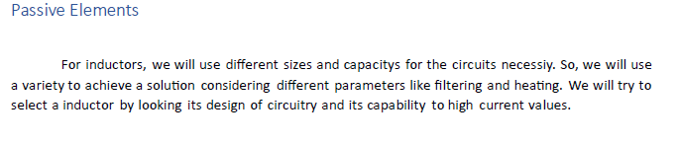
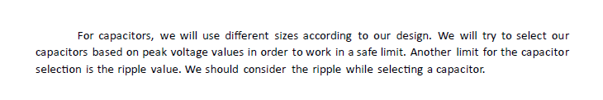

Slide 18
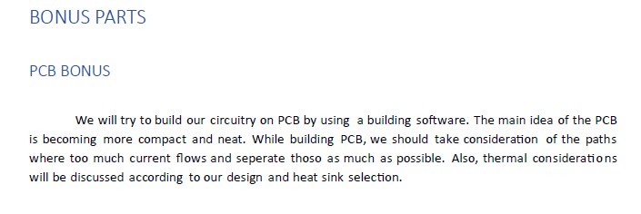
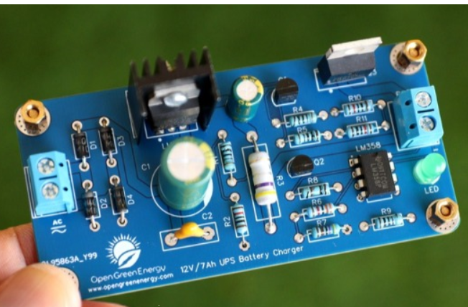
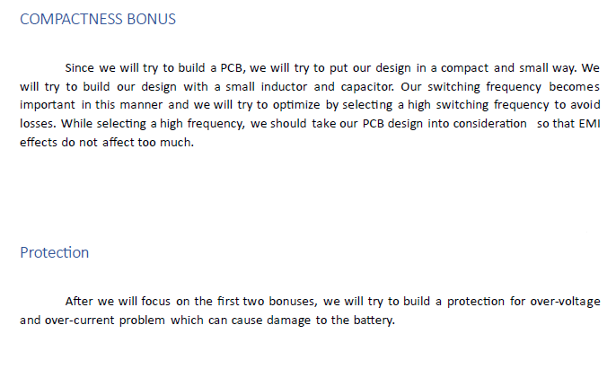
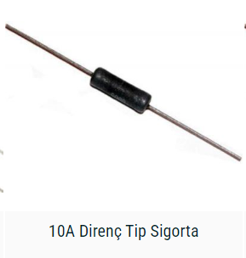
BONUS

